Slide 1

Free to ROM
- For Rehabilitation and Healthcare-
1

Slide 2



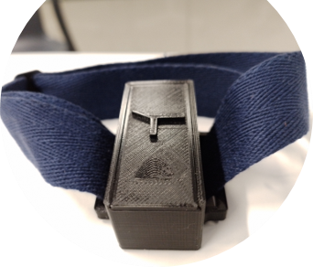
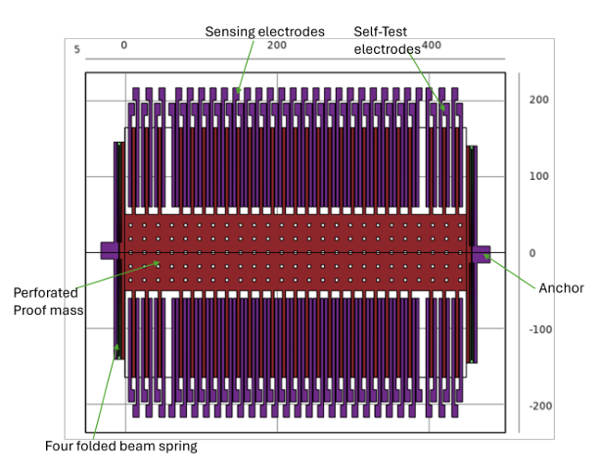
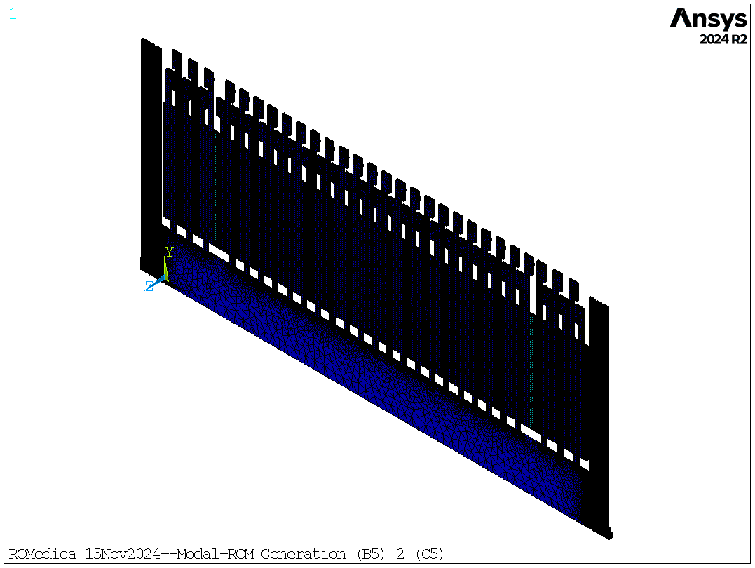
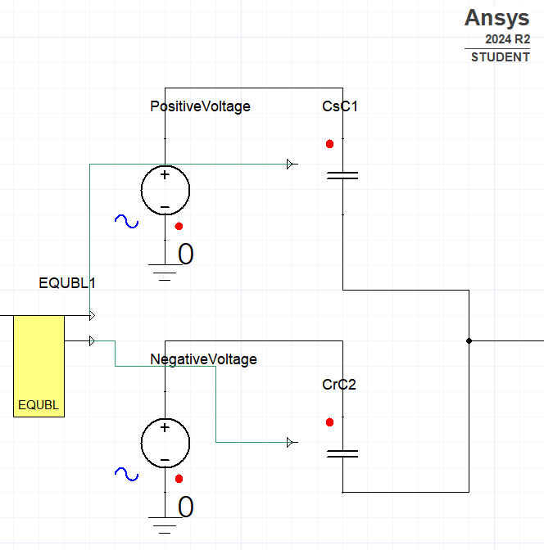

VALUE PROPOSITION & OVERVIEW
Do your rehab at home or anywhere, personalize your recovery plans, and stay motivated
Individuals
Elderly/Patients
Athletes
Neuro-patients
Businesses
Rehab Centers
Healthcare-C
Clinics
Prototyping
Sensor Design
ROM
Analog & Digital
Technical Tasks in pipeline
2

Slide 3



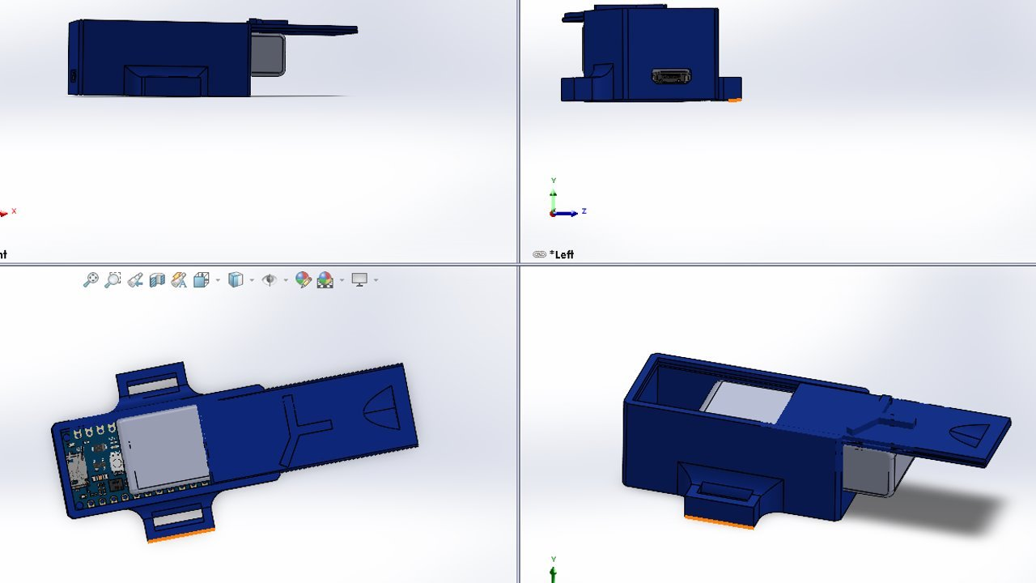
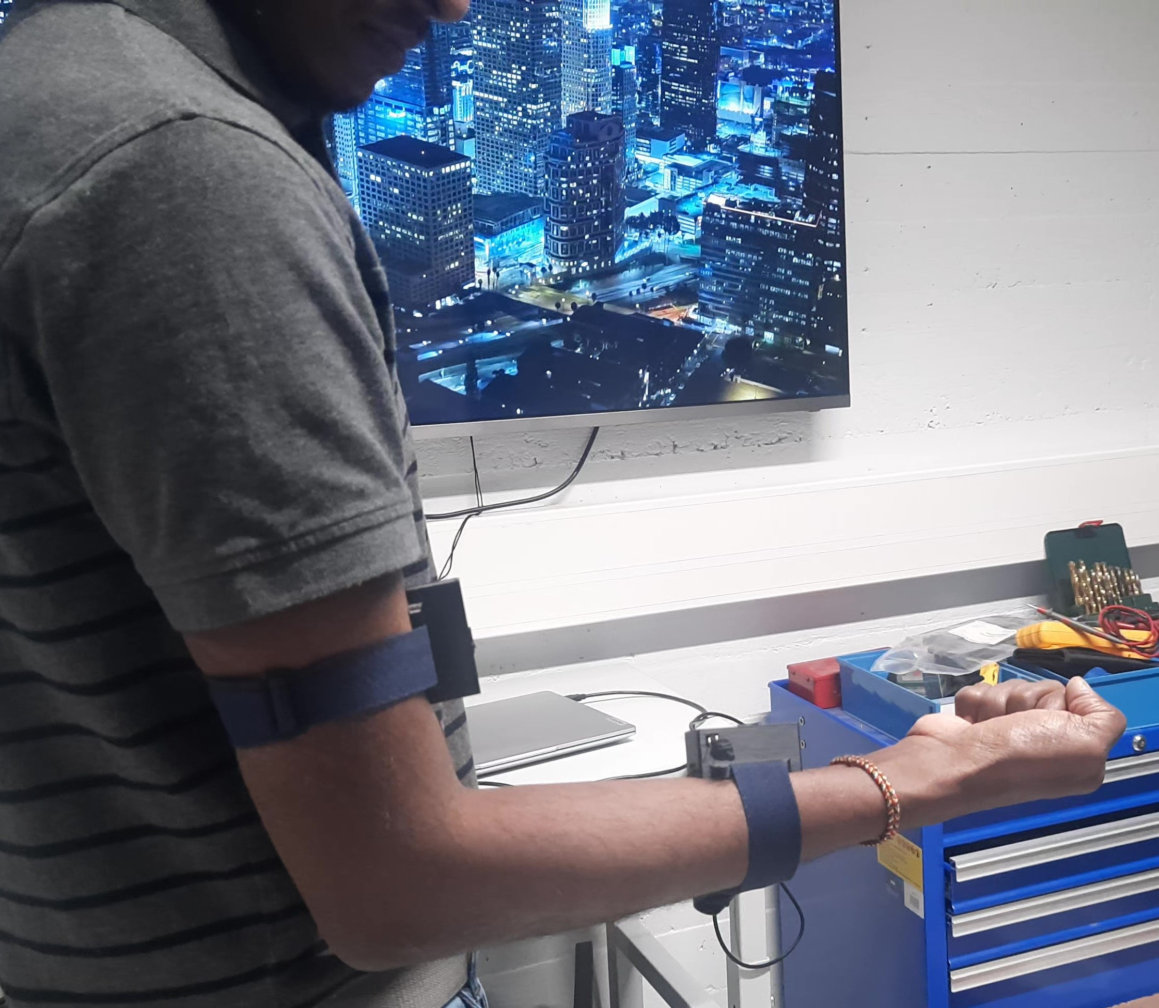
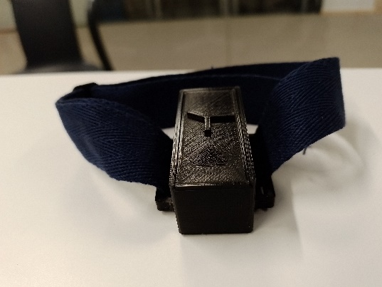
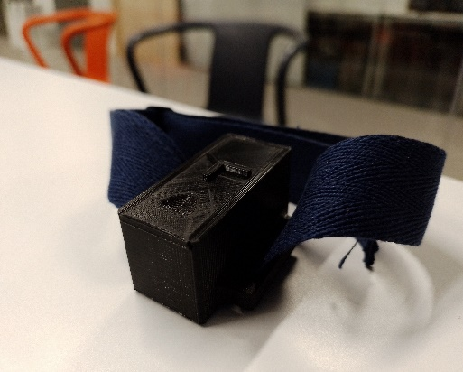
PROGESS AT AALTO -
Aalto: User Centric Approach
CAD Model - SolidWorks
3D Printing/Rapid Prototyping - PLA

Slide 4
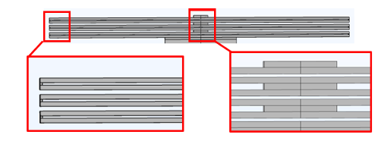
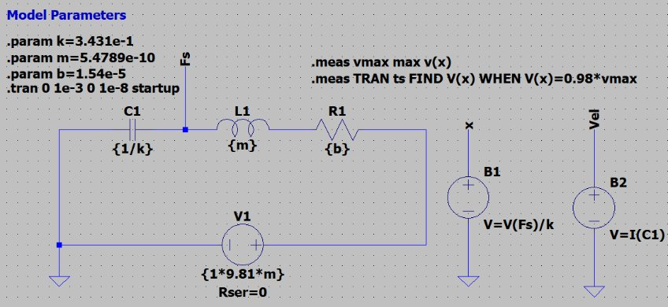


PROGESS AT USN -
Modeling Centric Approach
Modifications
*dimensions in µm
Sensor Design - COMSOL
Lumped Modeling

Slide 5
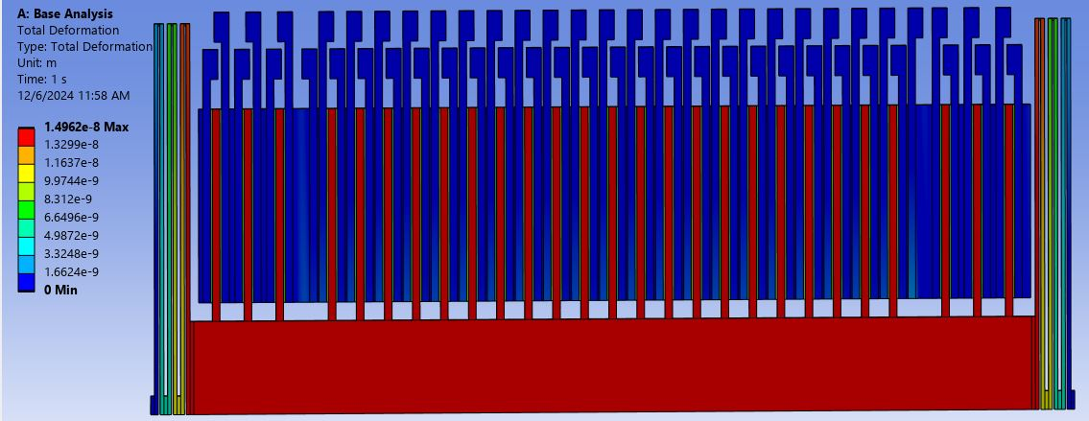


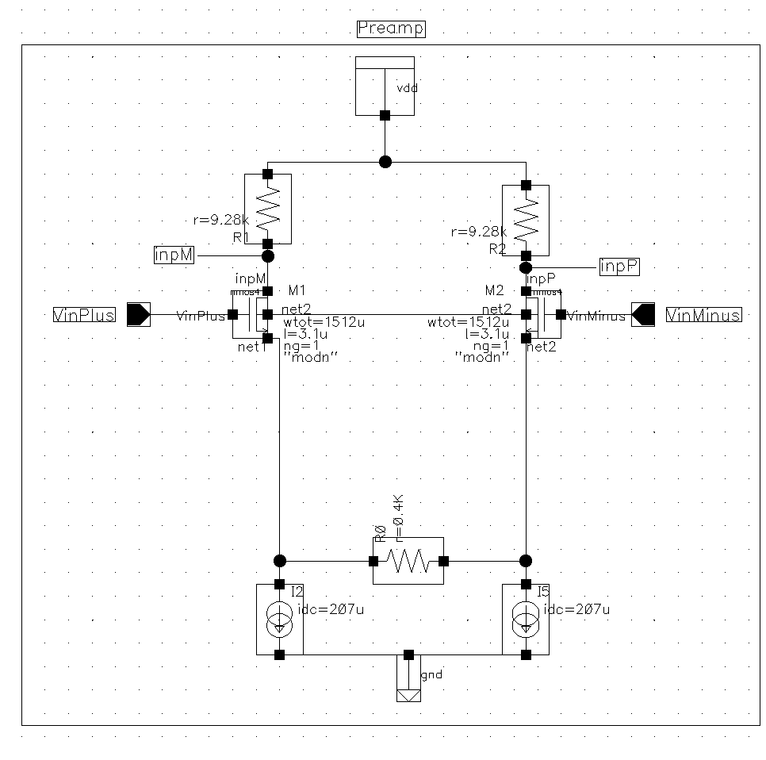
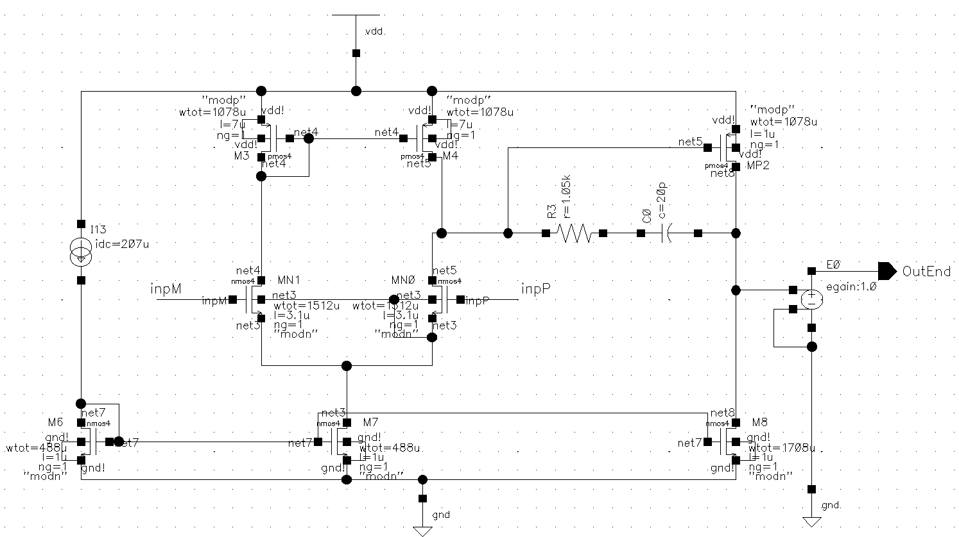

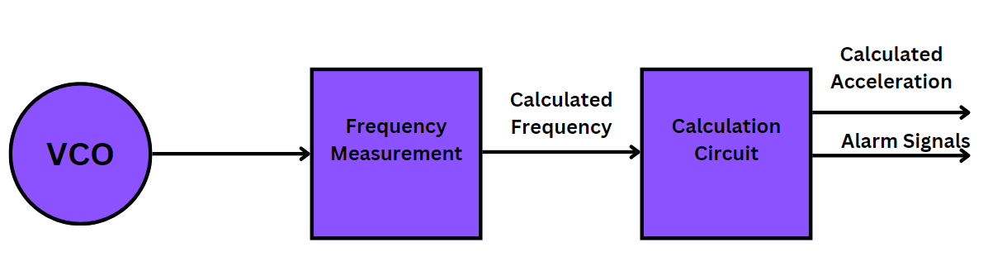

PROGESS AT BME -
Functional Centric Approach
FEM Simulation
ROM Design
Analog Design
Digital Design

Slide 6
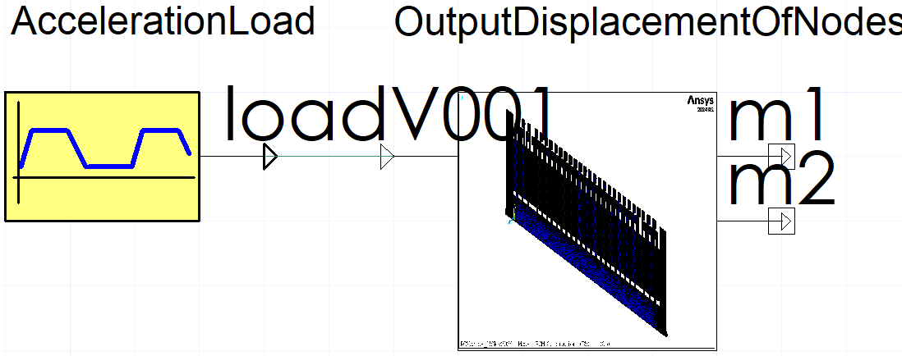
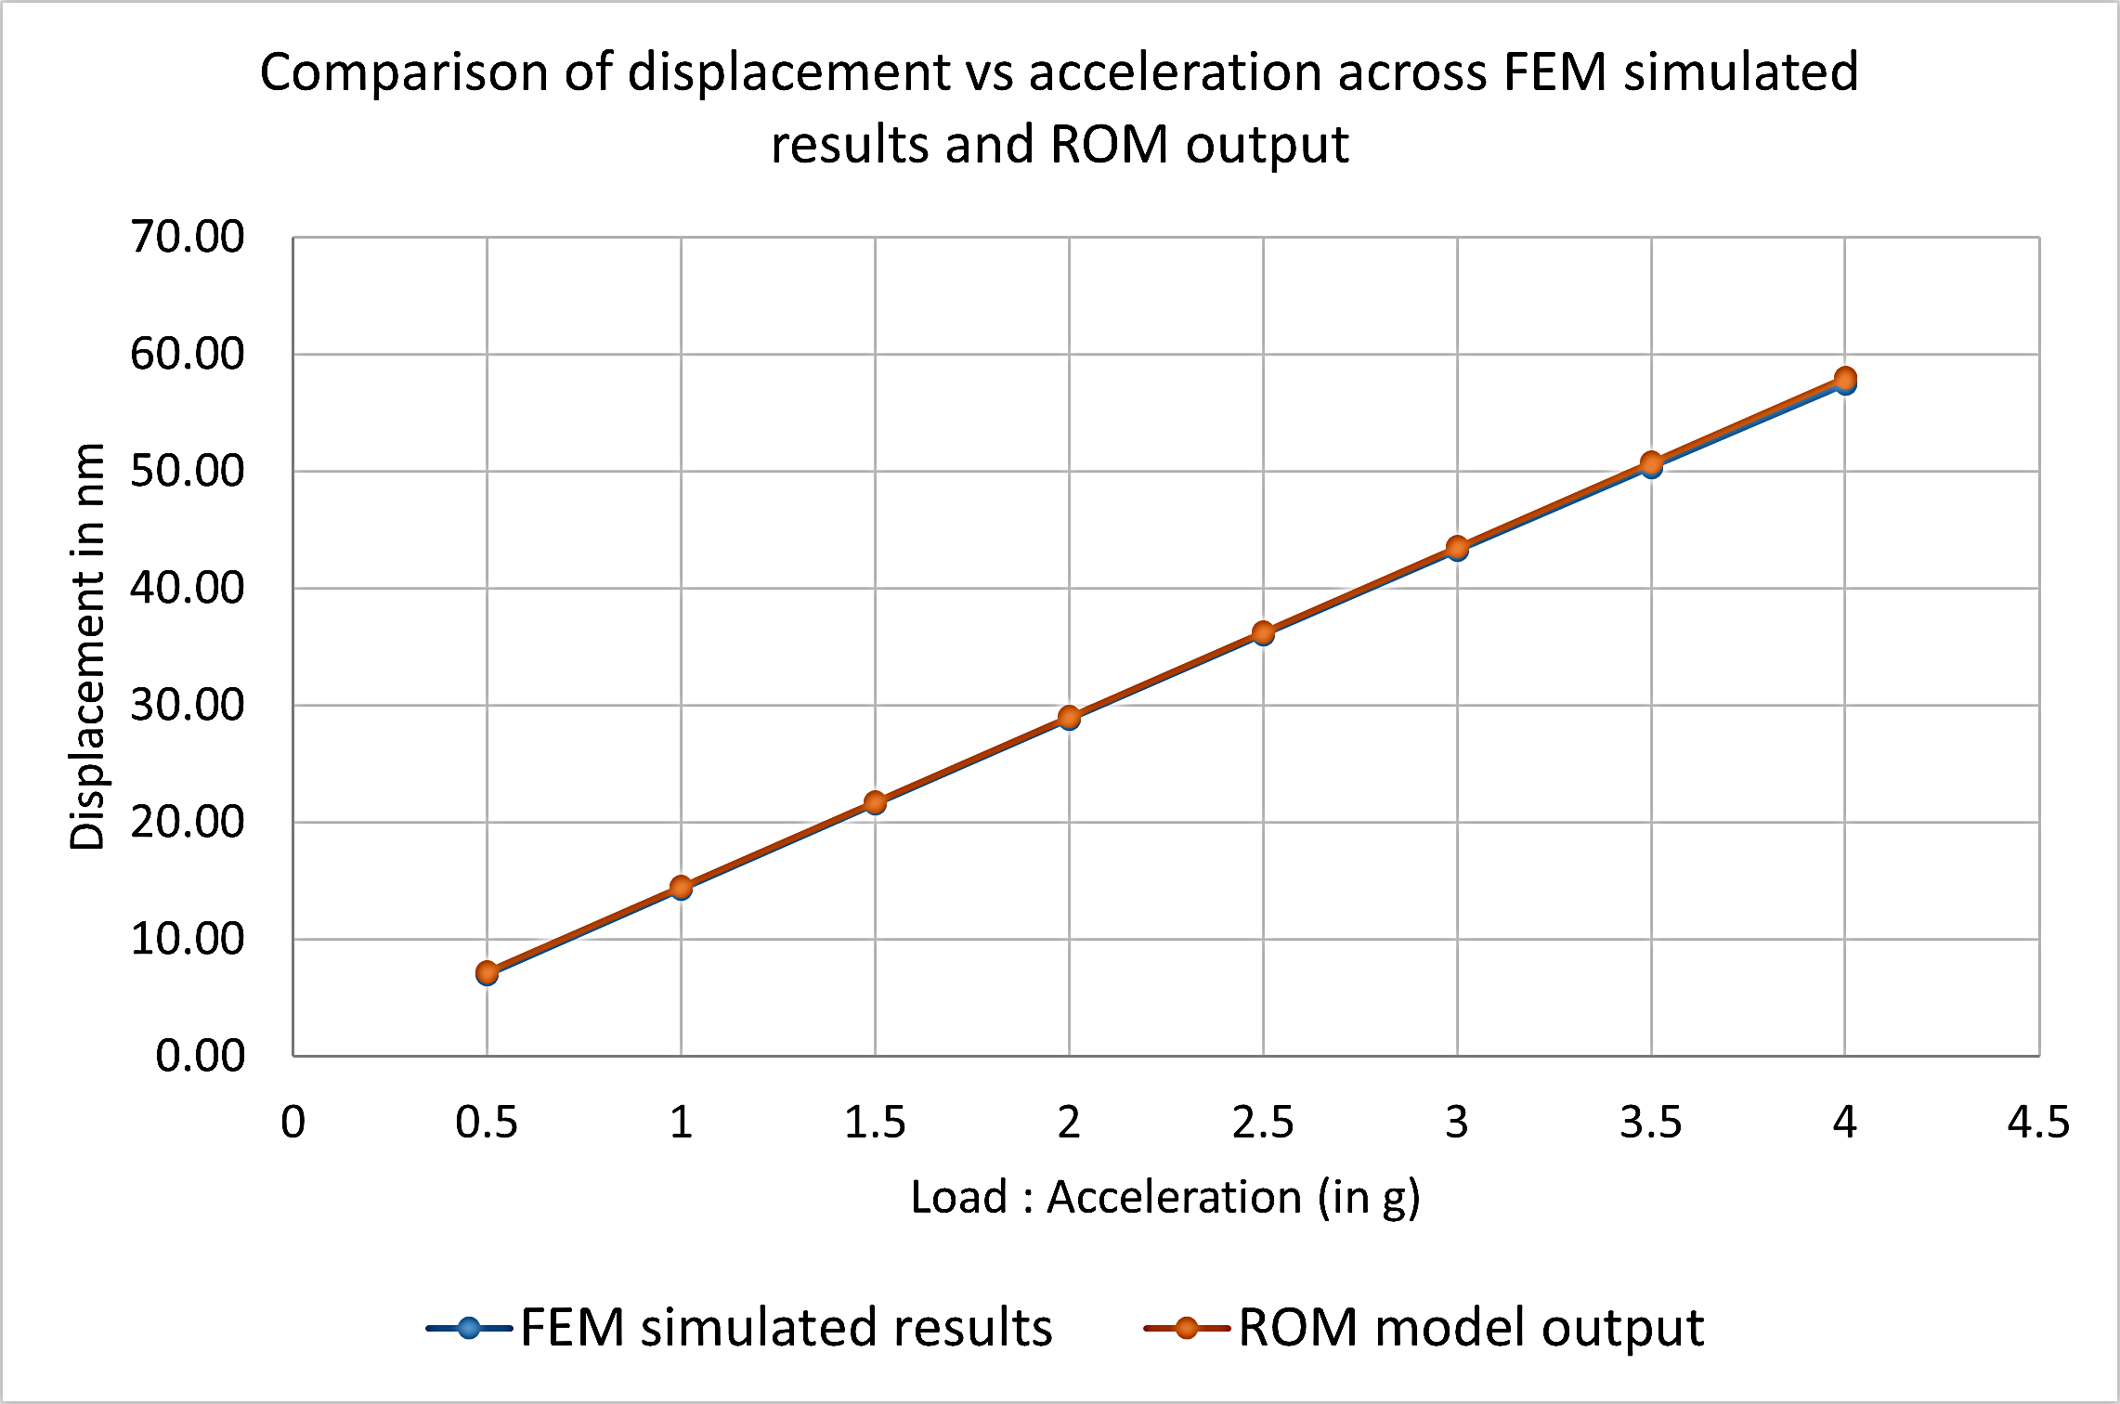
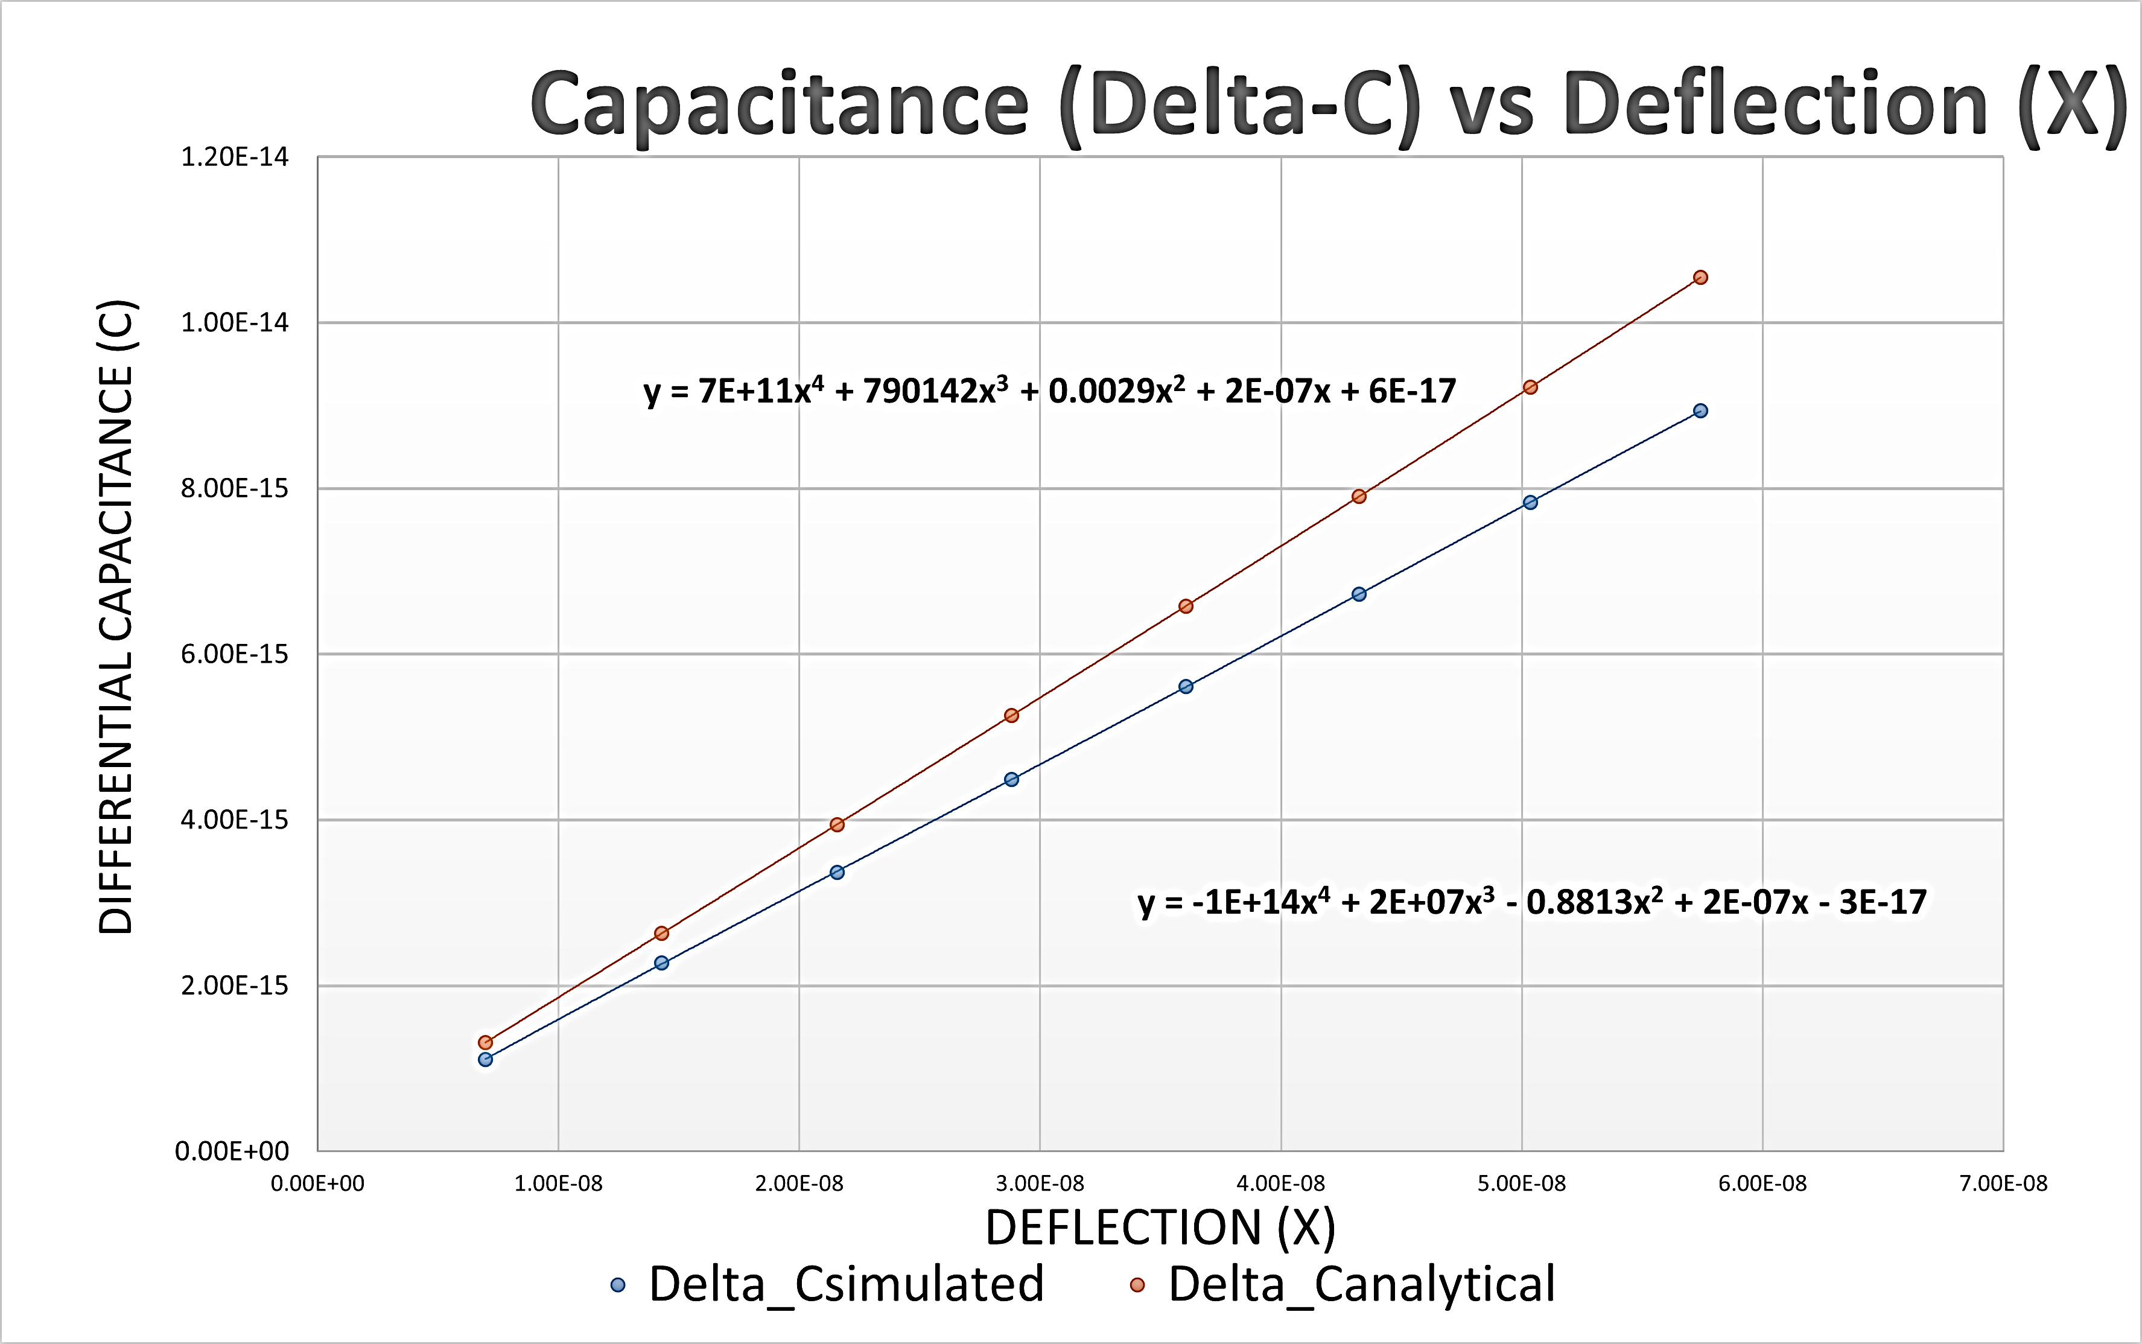
RESULTS
Sensor Analysis – ROM
Ready For Analog Domain

Slide 7
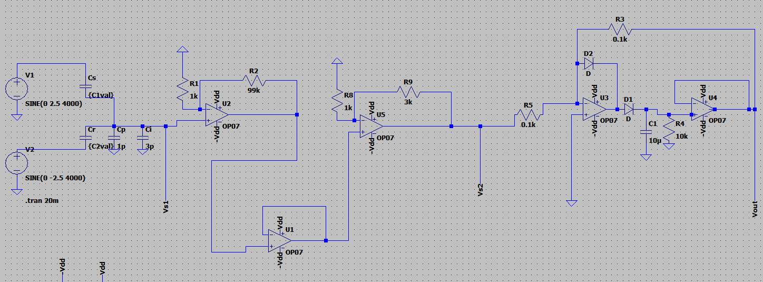
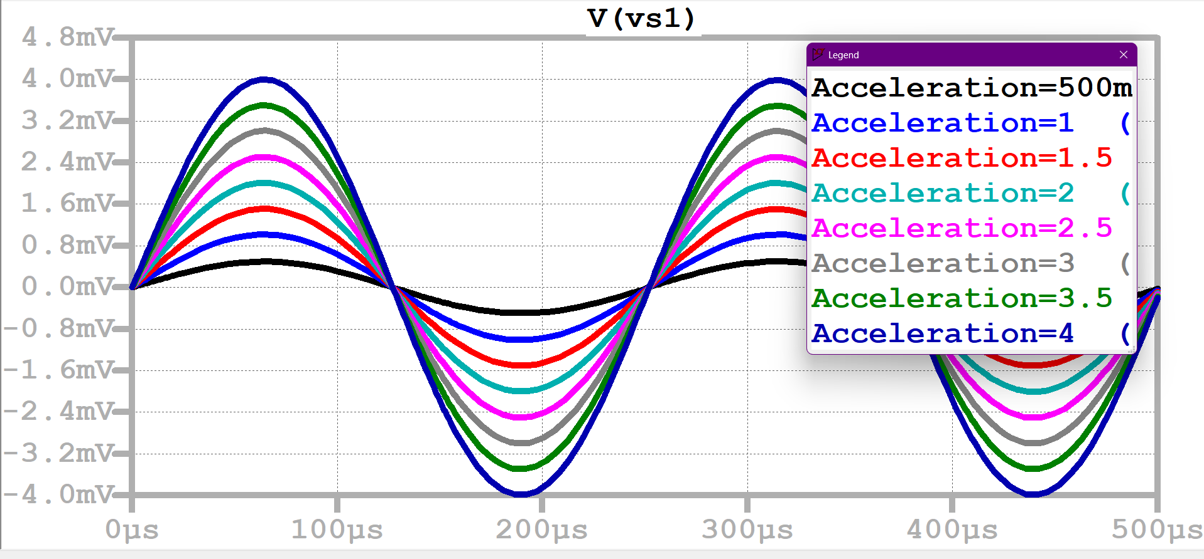
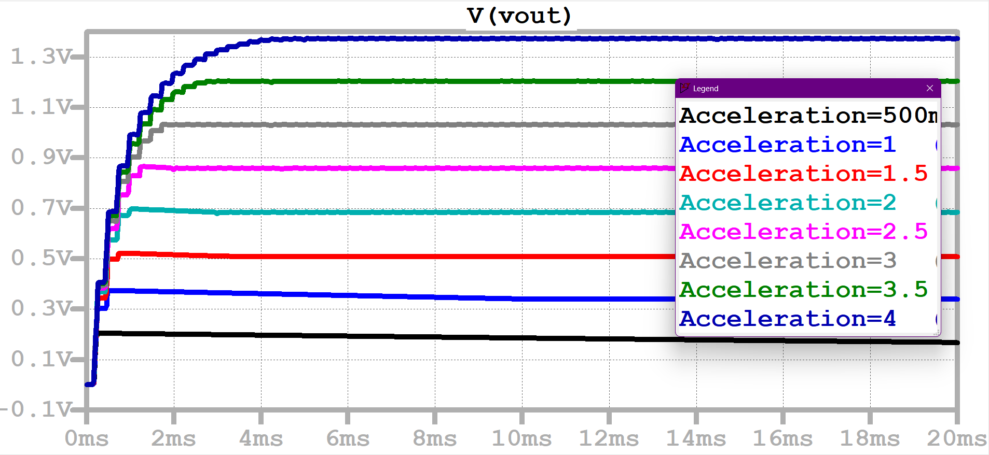
Capacitance(pF) to Voltage(mV)
Amplifier Stage (mV to V)
Peak detector
ANALOG
FemtoFarads to Volts
FemtoFarad to mV​
mV to V​
~1mV/g => 1000x amplification for 1V/g

Slide 8
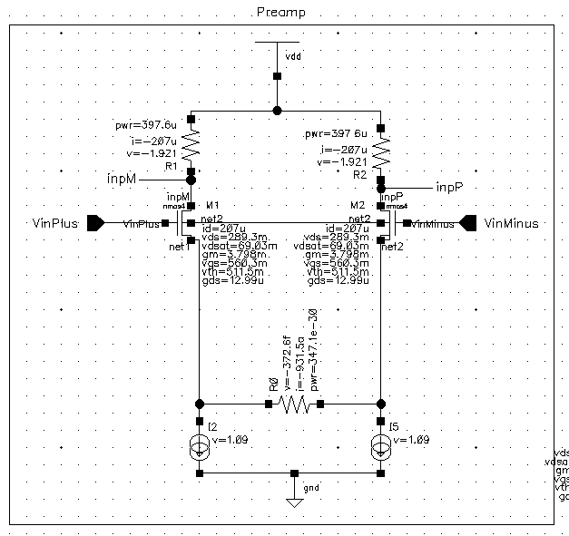
ANALOG
Op-amp Circuit Design and Analysis
Pre-amp Stage
Two-Stage​ Op-amp

Slide 9
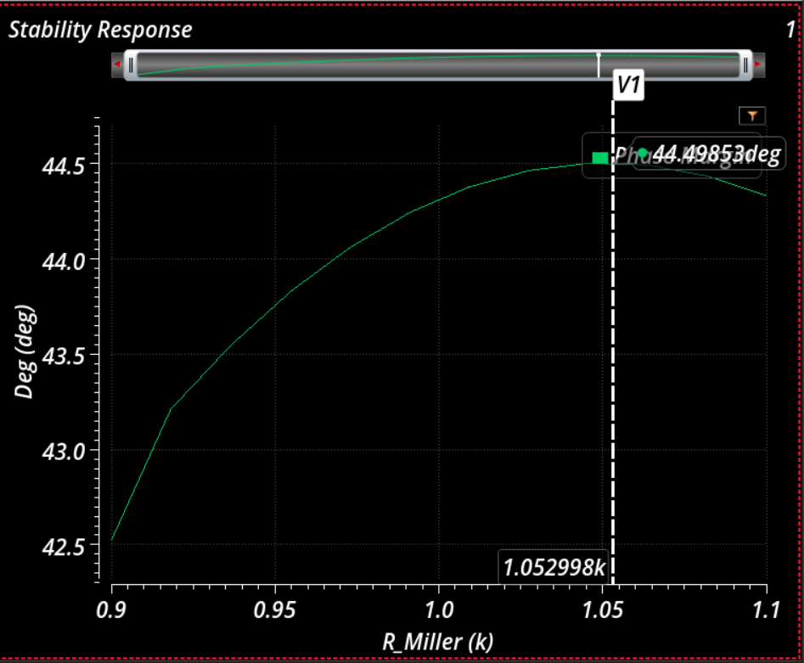
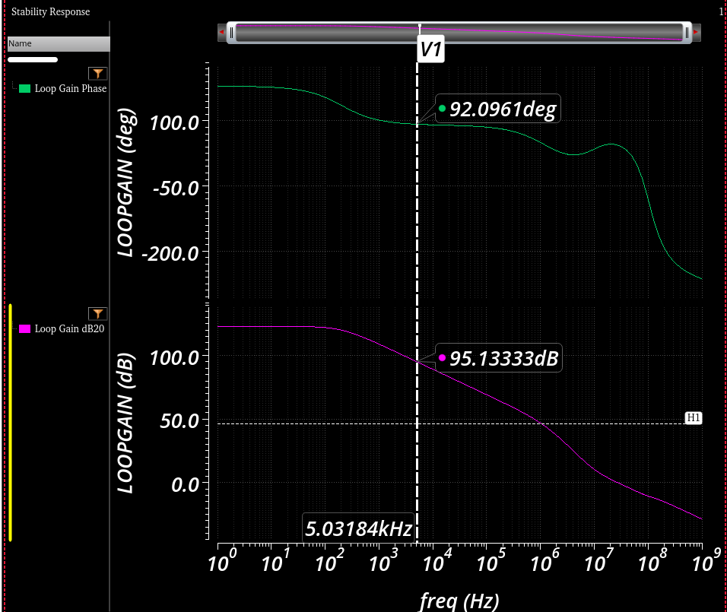
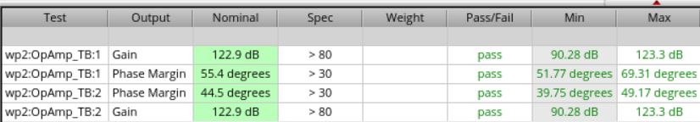
ANALOG
Op-amp Circuit Design and Analysis
Finding miller resistance
Stability Response
PVT Analysis

Slide 10
ANALOG
Circuit Design
Op-Amp
Specifications
Parameter | Value
Gain | ~123 dB
Gain at 5 kHz | 95 dB
Phase Margin | ~45°
GBW | 5000 kHz
Cutoff Frequency | 207 Hz
Percentage Error (for 1mV) | 0.10%

Slide 11
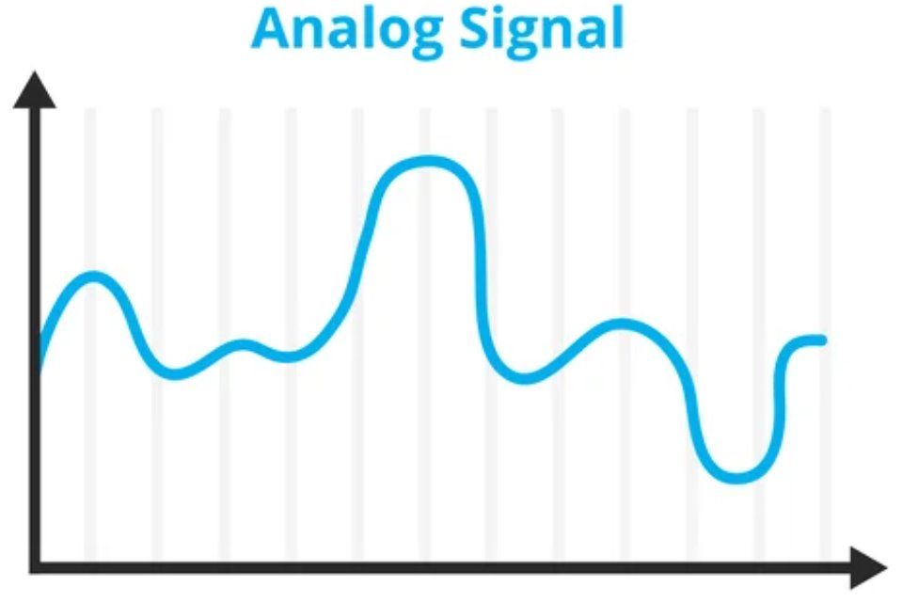

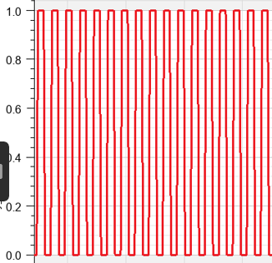
DIGITAL
- Approach and Design Consideration
Frequency Measurement
TIME_WINDOW
TIME_WINDOW
TIME_WINDOW
Time Window = 10 us
Clock = 50 MHz
g
g
g
​
-4<=g<=4
Fmin >= Fmin time window
10 MHz
Decision Circuit
2 Fmax < F Clock
18 MHz

Slide 12
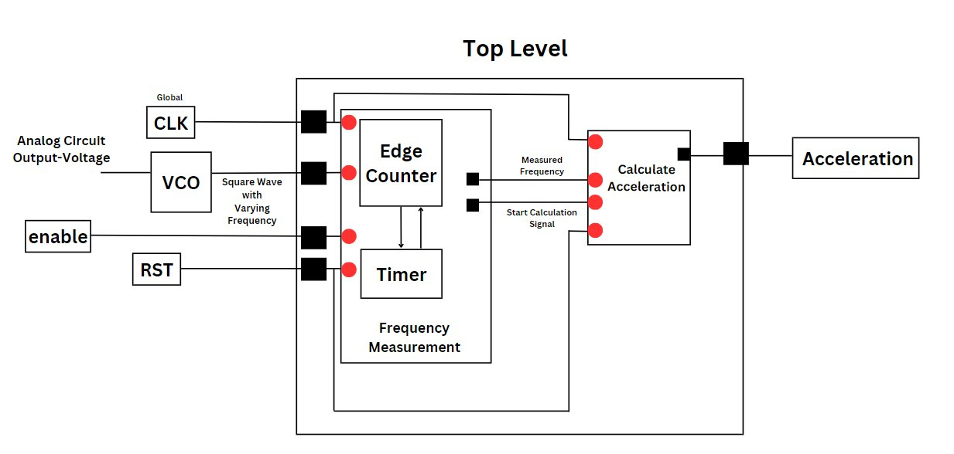


DIGITAL
- Approach and Design Consideration
Hierarchal Design
Metastability Handling

Slide 13
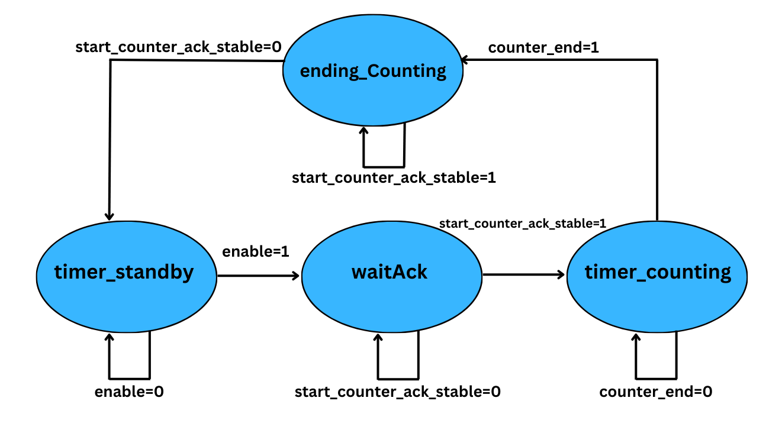
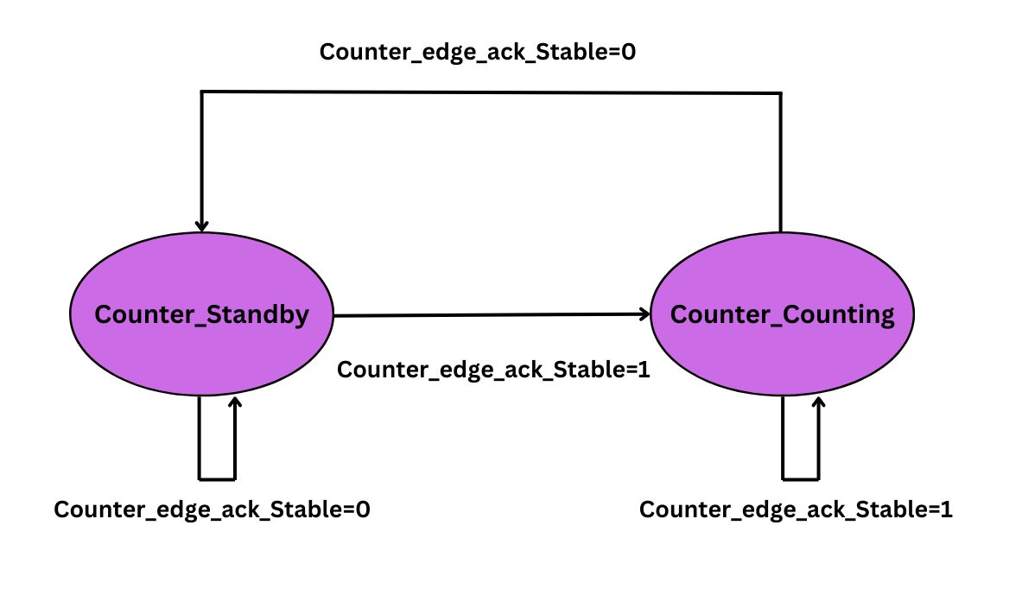
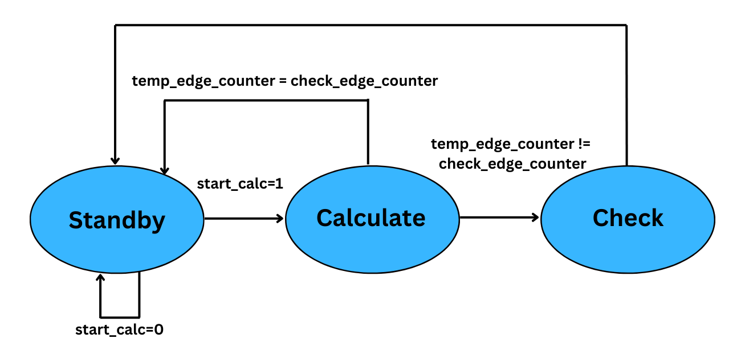
DIGITAL
- Approach and Design Consideration

Slide 14
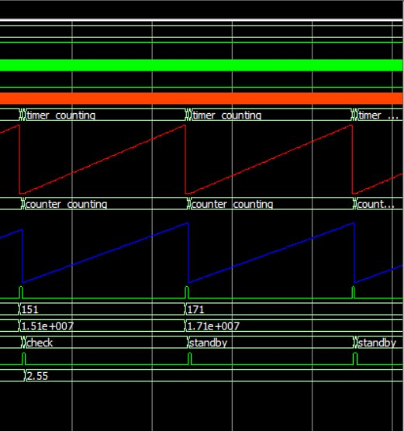
TESTING
START
- System Functional Testing
Timer= limit ?
NO
clk
YES
count end
Freq_in
Final Edge Count
Counter + 1
151
Calc Frequency
151 MHz
Start calc
Calc Acceleration
Reset Timer, Counter and flags
2.55
Each Time Window
Finite State Machine

Slide 15
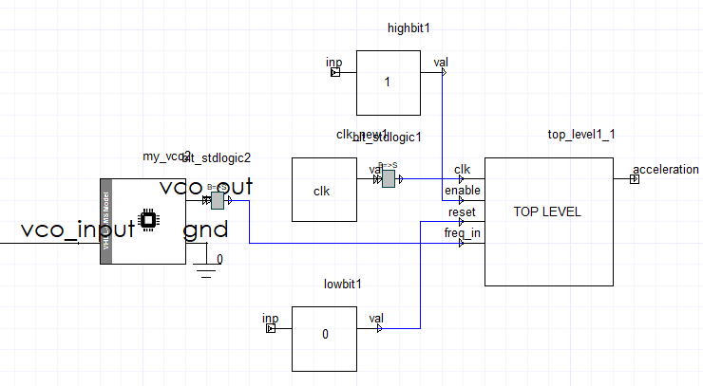
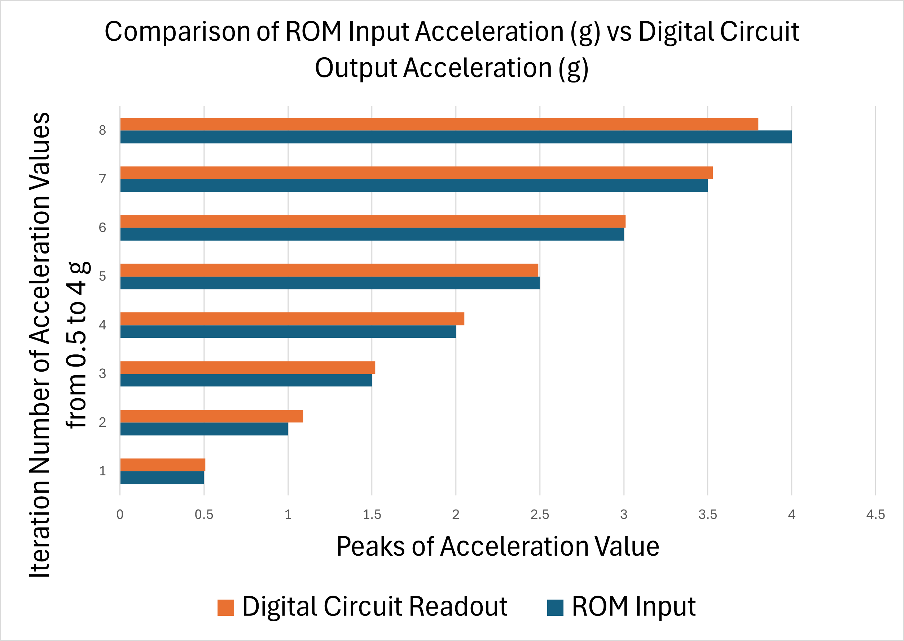
TESTING
- System Functional Testing
System in Twin-Builder
Results

Slide 16
CONCLUSION
- Challenges & Future Ideas, Improvements
Parameters | Specifications | Remarks
Acceleration | -4 to 4 g | Achieved and Tested
Temperature Range | Up to 51 degrees | Electrical Test Only - Passed
Physical Prototype | PLA Material | Exist in Desired Dimensions
Frequency Response | 10Hz to 5 kHz | Tested
Future :
Bulk proof mass Accelerometer
Key Issues :
Complex Geometry
Low sensitivity (fF/g) -> Extreme Amplification required.

Slide 17
THANK YOU!
As we look to the future, these technologies will play a crucial role in shaping a better world for generations to come.

Slide 18
Contributors -
Ashutosh Sharma
Vaigunthan Puvanenthiram
Mayada
Nabeel Jadon

